Slide 1
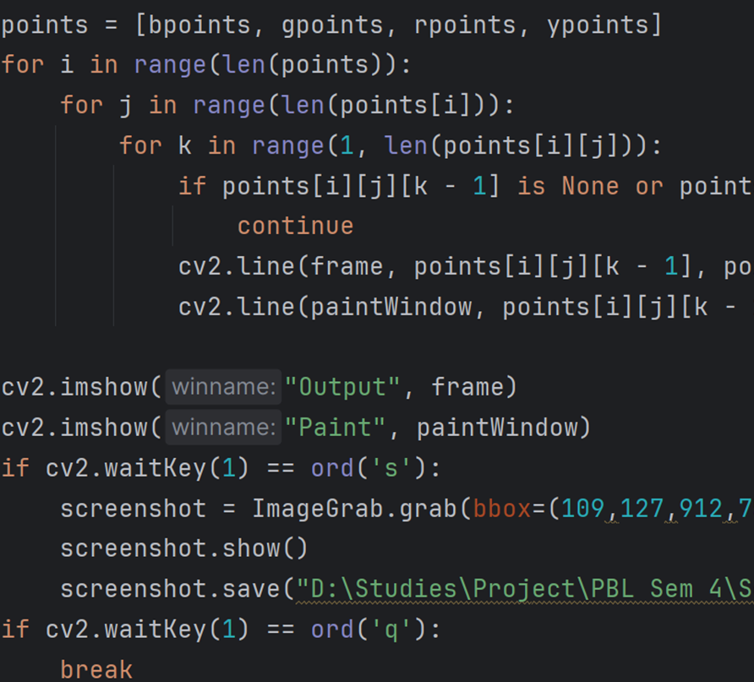
Air Canvas – A Virtual Pen
By-
Darshita Singh (229310009)
Chaitanya Sekra (229310016)

Slide 2
Problem Statement
The problem statement for this project is to create an innovative and cost-effective virtual hand gesture painting system that enables users to draw shapes and text in a digital environment using hand gestures. The challenge is to design a system that accurately recognizes and translates these gestures into digital strokes on a virtual canvas, allowing for an intuitive and immersive drawing experience. This project aims to overcome the limitations of traditional input devices and provide an interactive platform for creative expression, making digital art more accessible and engaging for a wide range of users. regardless of their technical expertise or familiarity with specialized tools

Slide 3
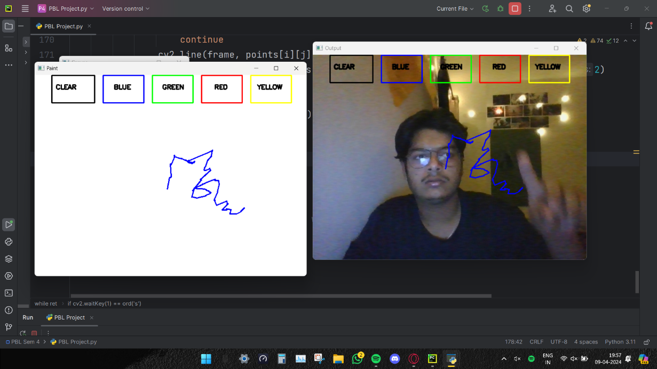
INTRODUCTION
The Air Canvas project aims to develop a virtual canvas where users can draw and interact with digital content using hand gestures and movements. Leveraging machine learning and computer vision techniques, this project intends to create an intuitive interface for artistic expression and digital collaboration.

Slide 4
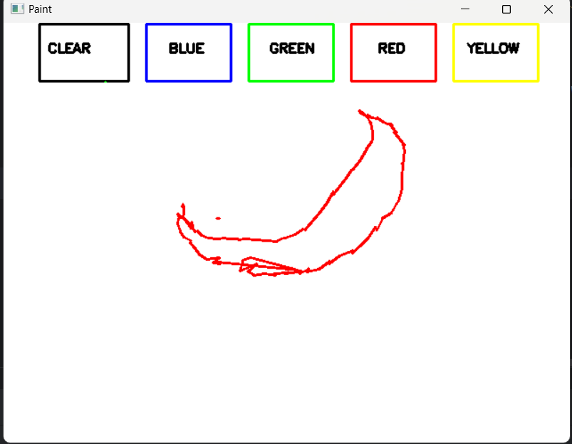
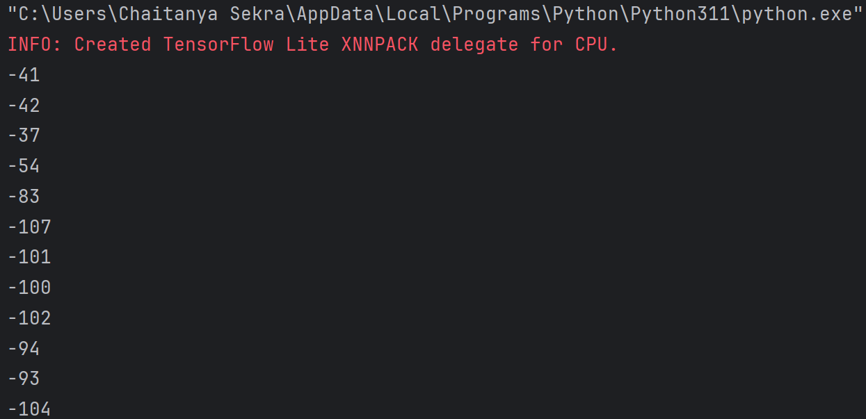
Air Canvas OVERVIEW
This project involves the implementation of sophisticated color recognition and tracking methods. These techniques allow users to wield a "virtual pen" and create digital masterpieces by simply moving their hand. It offers a immersive experience that closely emulates the sensation of painting.

Slide 5
Features
i. Color change: Users should be able to select from a variety of colors for drawing.
ii. Clear screen: User should have the ability to clear the canvas to start fresh
iii. Air drawing: The application should recognize hand gestures and movements to draw on the canvas.
iv. Saving the canvas: User should be able to save the drawing for future reference or sharing.

Slide 6
Tools/Techniques to be used :
Python: The primary programming language for implementing the project.
OpenCV: For computer vision tasks, including hand gesture recognition and tracking.
Machine Learning Libraries: Such as TensorFlow or PyTorch for training models to recognize gestures and interpret user actions

Slide 7
Tools/Techniques to be used :
GUI Framework: A framework like Tkinter or PyQt for building the graphical user interface.
Networking Libraries: For enabling real-time collaboration features, socket programming libraries will be used.
Image Processing Libraries: Libraries like PIL (Python Imaging Library) for processing and manipulating digital images.
Version Control: Git for managing the project's source code and facilitating collaboration among team members.

